Slide 1
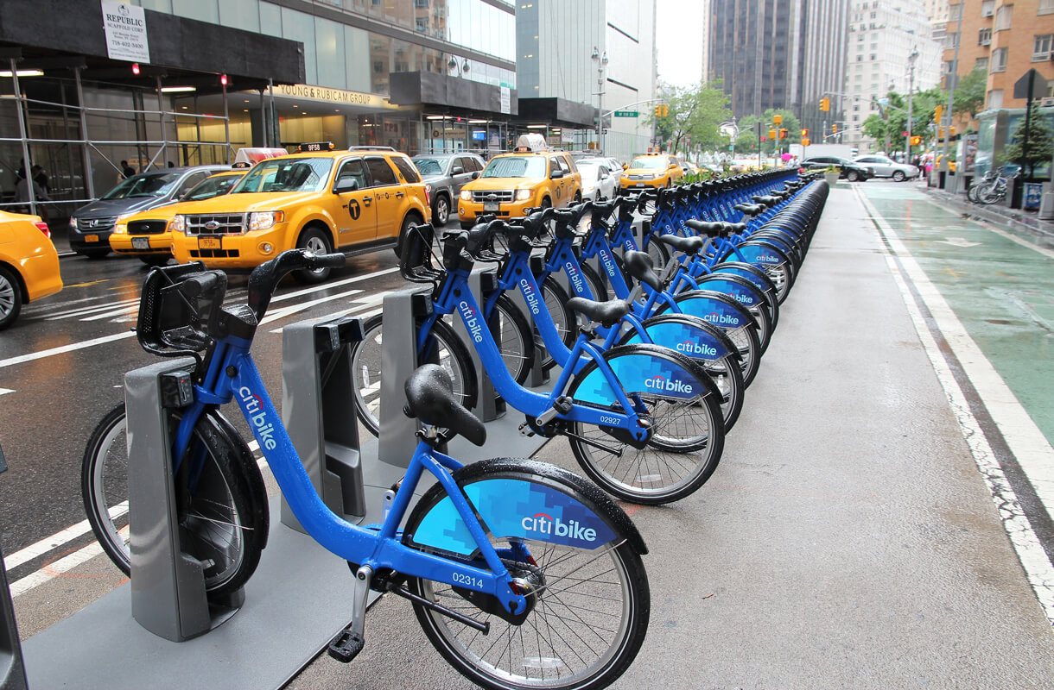
SAN FRANCISCO BIKE SHARE
ANANT AGARWAL
ARPITA JENA
ASMITA VIKAS
DEENA LIZ JOHN

Slide 2
INTRODUCTION
BUSINESS PROBLEM
DATA DESCRIPTION
IMPLEMENTATION IN SPARK
RECOMMENDATION AND CONCLUSION
LESSONS LEARNED

Slide 3
Introduction
Pick up a bike at any Ford GoBike station.
Ride across SF for quick trips!
End a trip by returning at any bike station.

Slide 4
Business Problem
With Ford GoBike App, real-time bike availability information can be tracked.
We propose a recommendation system for customers to plan trips in advance by predicting availability for next two days.

Slide 5
Data Description
Nearly 2.5 GB data from Ford GoBike data release containing trip information.
Four years data from January 2013 to December 2016.
Nearly 71 million trip information.
Over 30 features of weather information was used as external data.

Slide 6
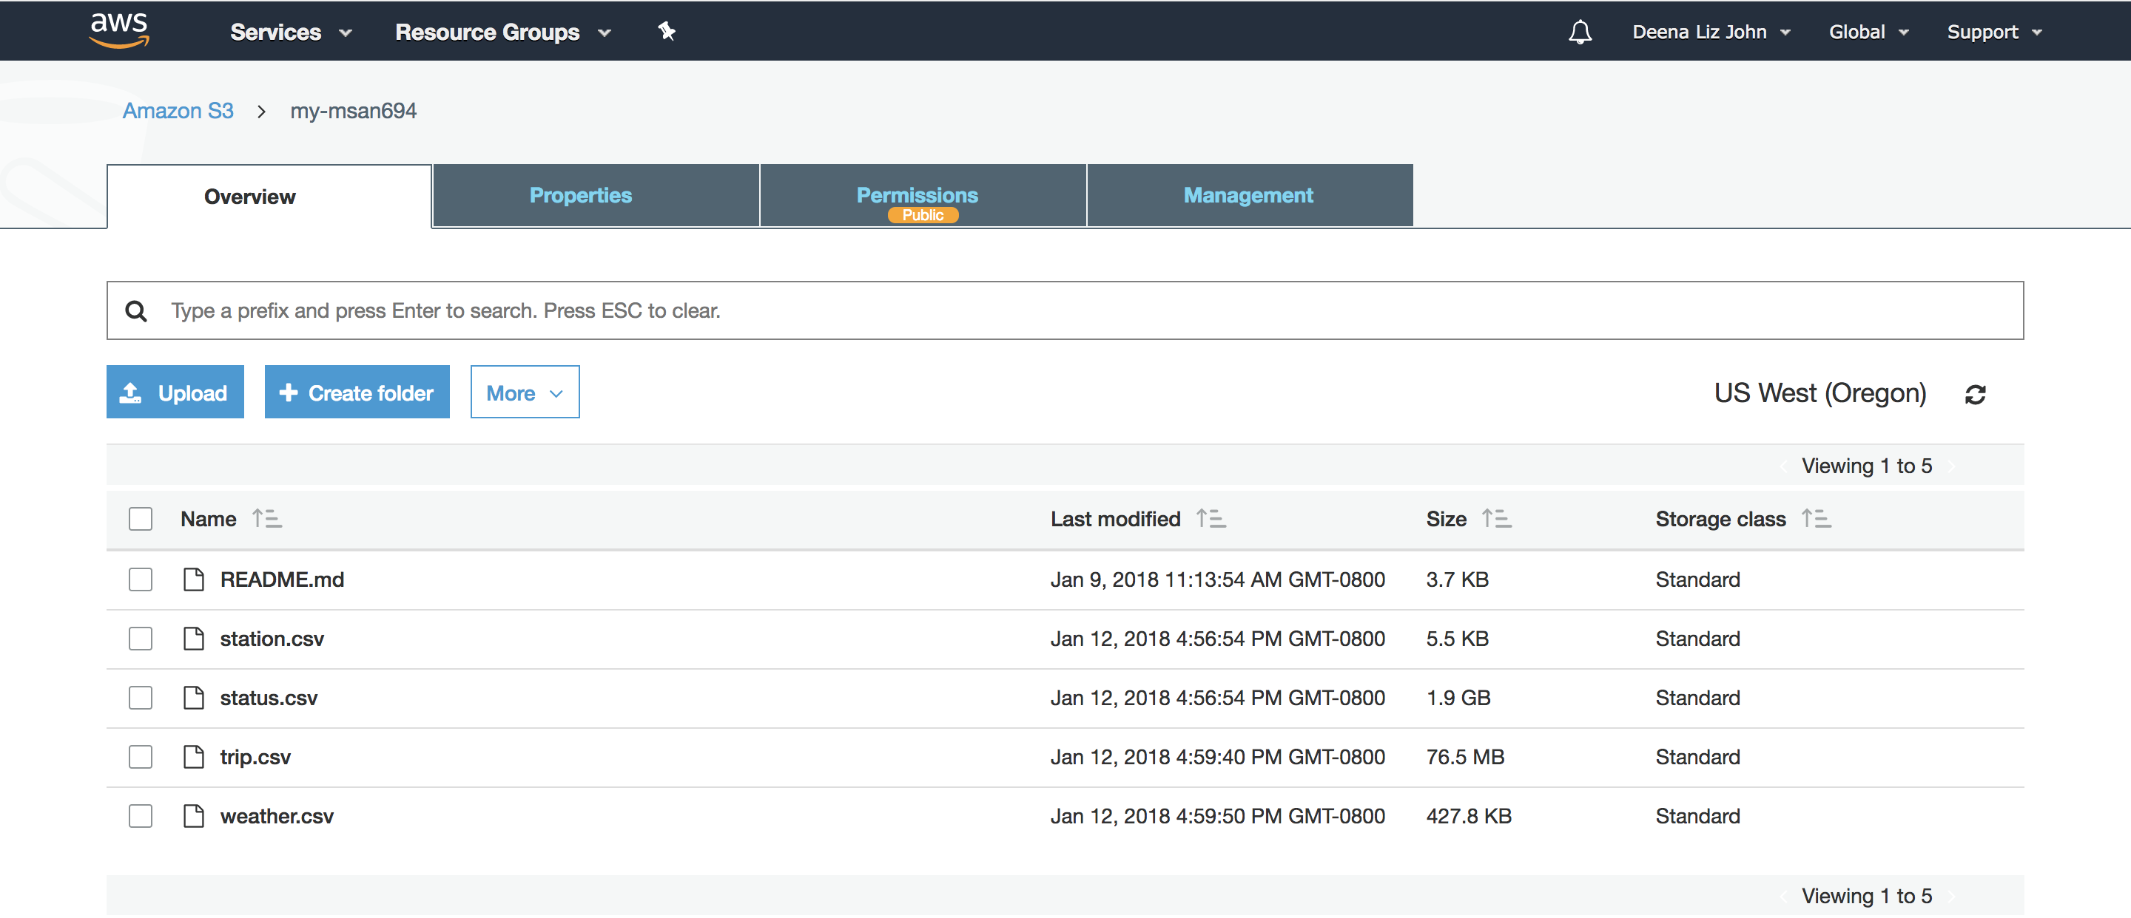

Implementation in Spark
Data loaded in S3
EC2 Instance

Slide 7
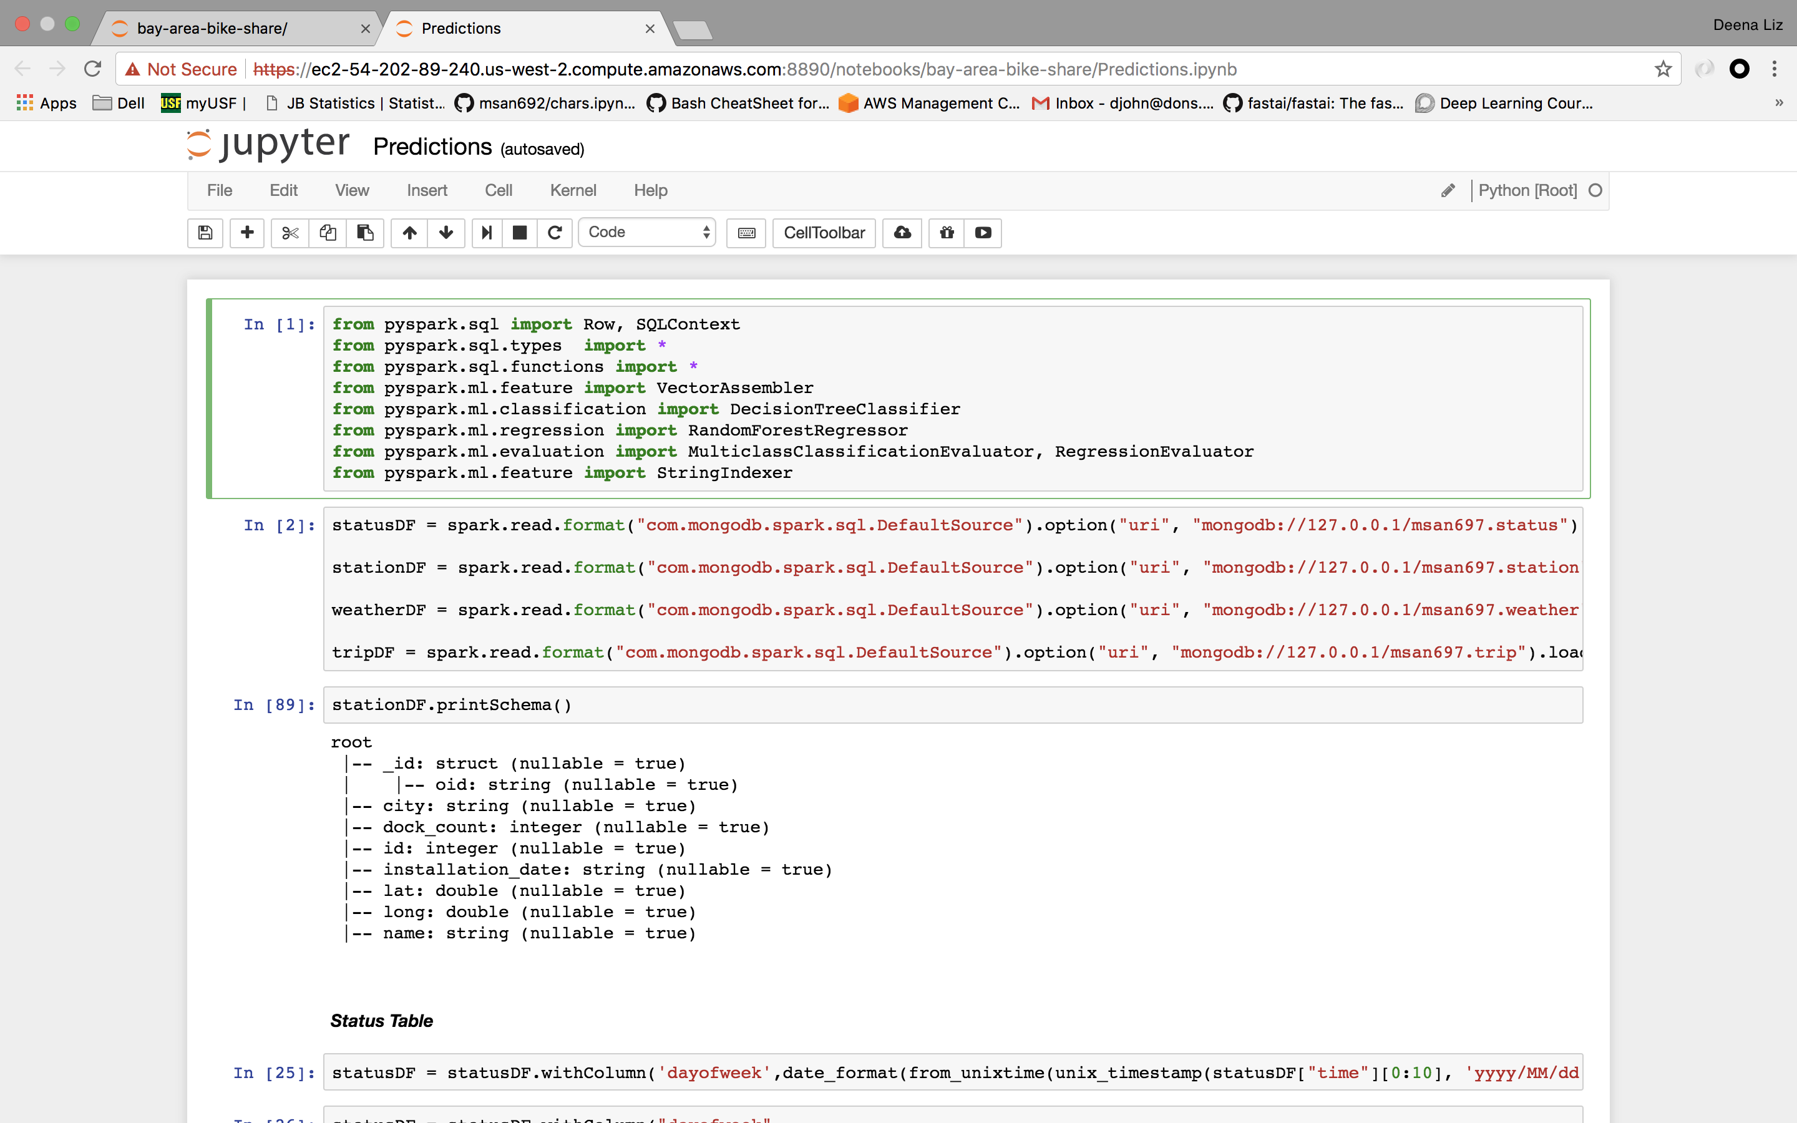
Querying on EC2

Slide 8
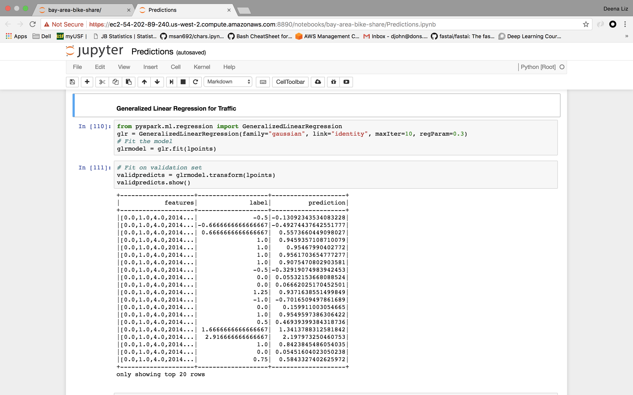
Implementing Generalized Linear Regression model to predict Traffic

Slide 9
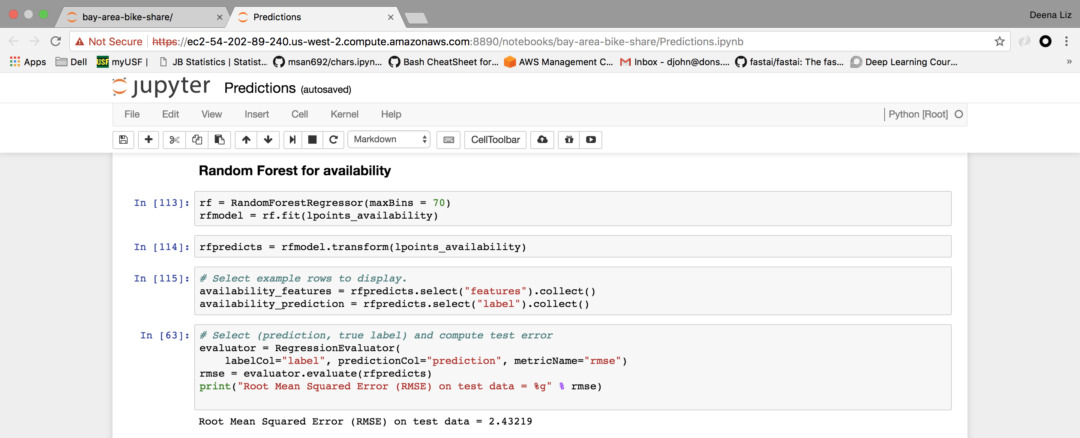
Implementing Random Forest model to predict Availability

Slide 10
Model Description

Slide 11
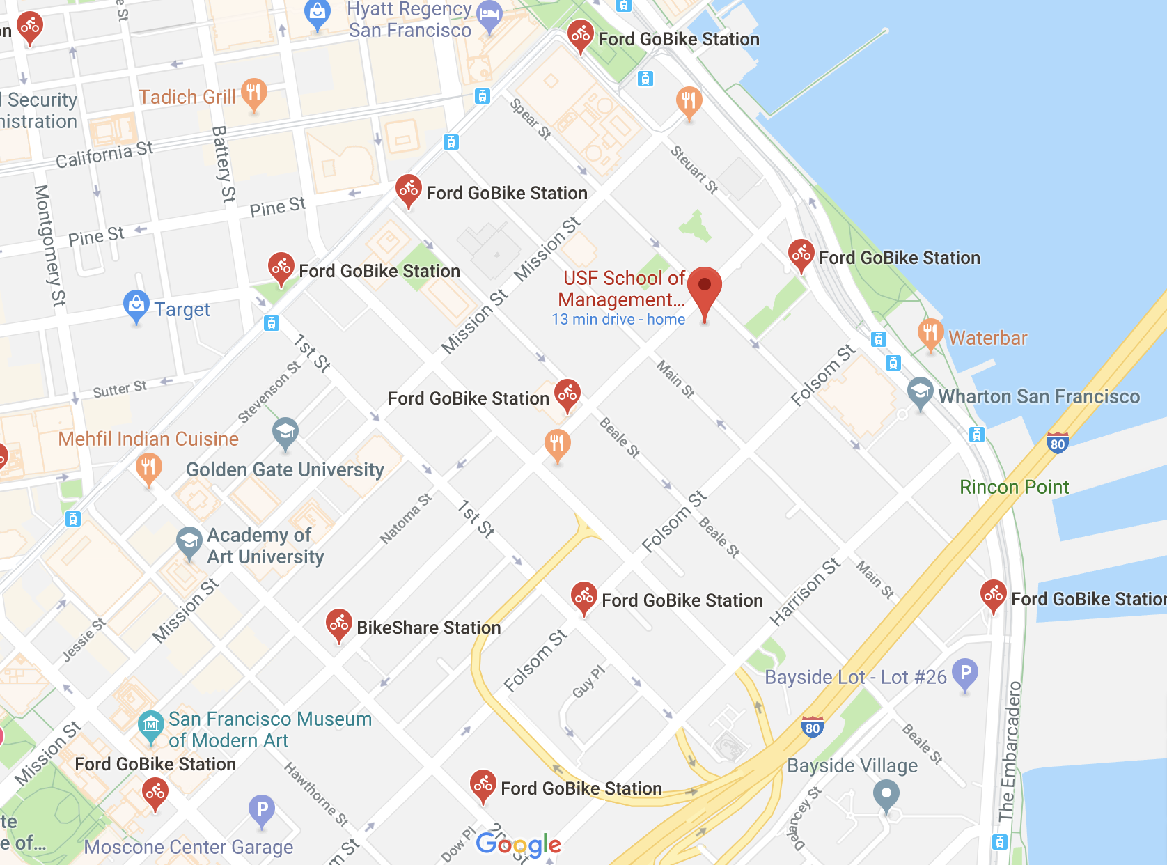
Recommendation System
Stations closest to the specified location are considered for recommendation.

Slide 12
Recommendation based on distance, bikes available and traffic.

Slide 13
Lessons Learned

Slide 14
THANK YOU

